Slide 1
Needfinding in Self Care
Ashwin Agarwal
Claire Shu
Josh Lange
Katherine Eisenbrand

Slide 2

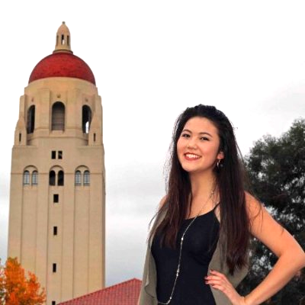
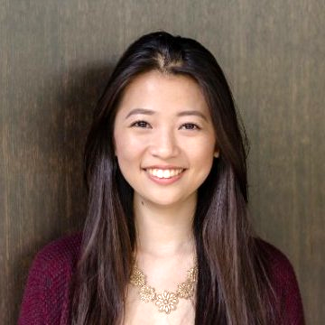
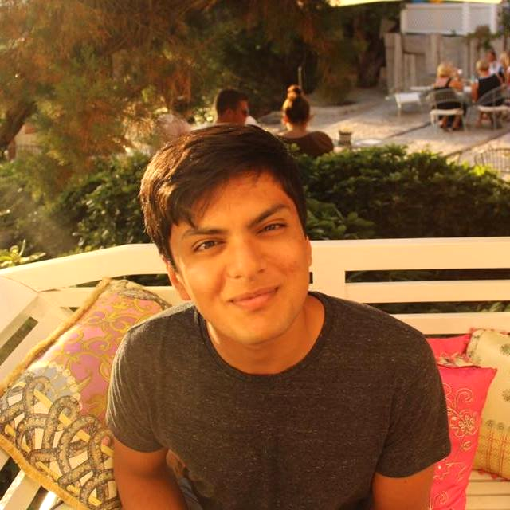

Slide 3
Introduction
Problem: How do people self-monitor their living habits?
Question: Can we help people learn better self-care habits?

Slide 4
Questions Asked
How do you self-monitor bad habits?
How often do you think about your overall mental state? What prompts you to think about it?
Tell me about a time you’ve been proud of the way you took care of yourself? A time you’ve struggled?
How do you define self care?
What has been the hardest part about taking care of yourself away from home?
What do you think people can learn in order to take care of themselves better?

Slide 5
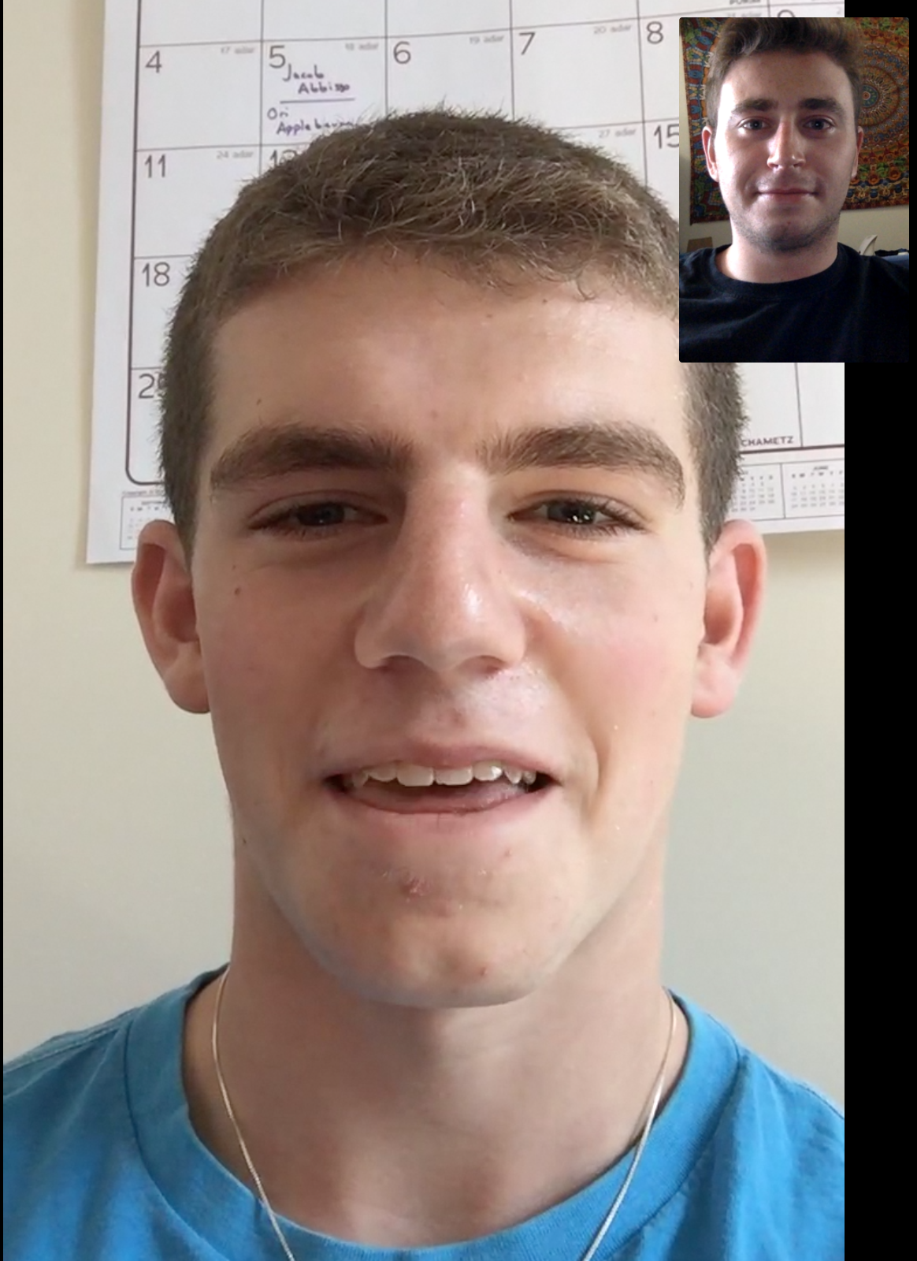
Interview 1 - Teenage Boy in High School
Senior in high school in MA
Captain of his soccer, basketball team
In a 2 year relationship
Atypical user
*Interview conducted over FaceTime*

Slide 6
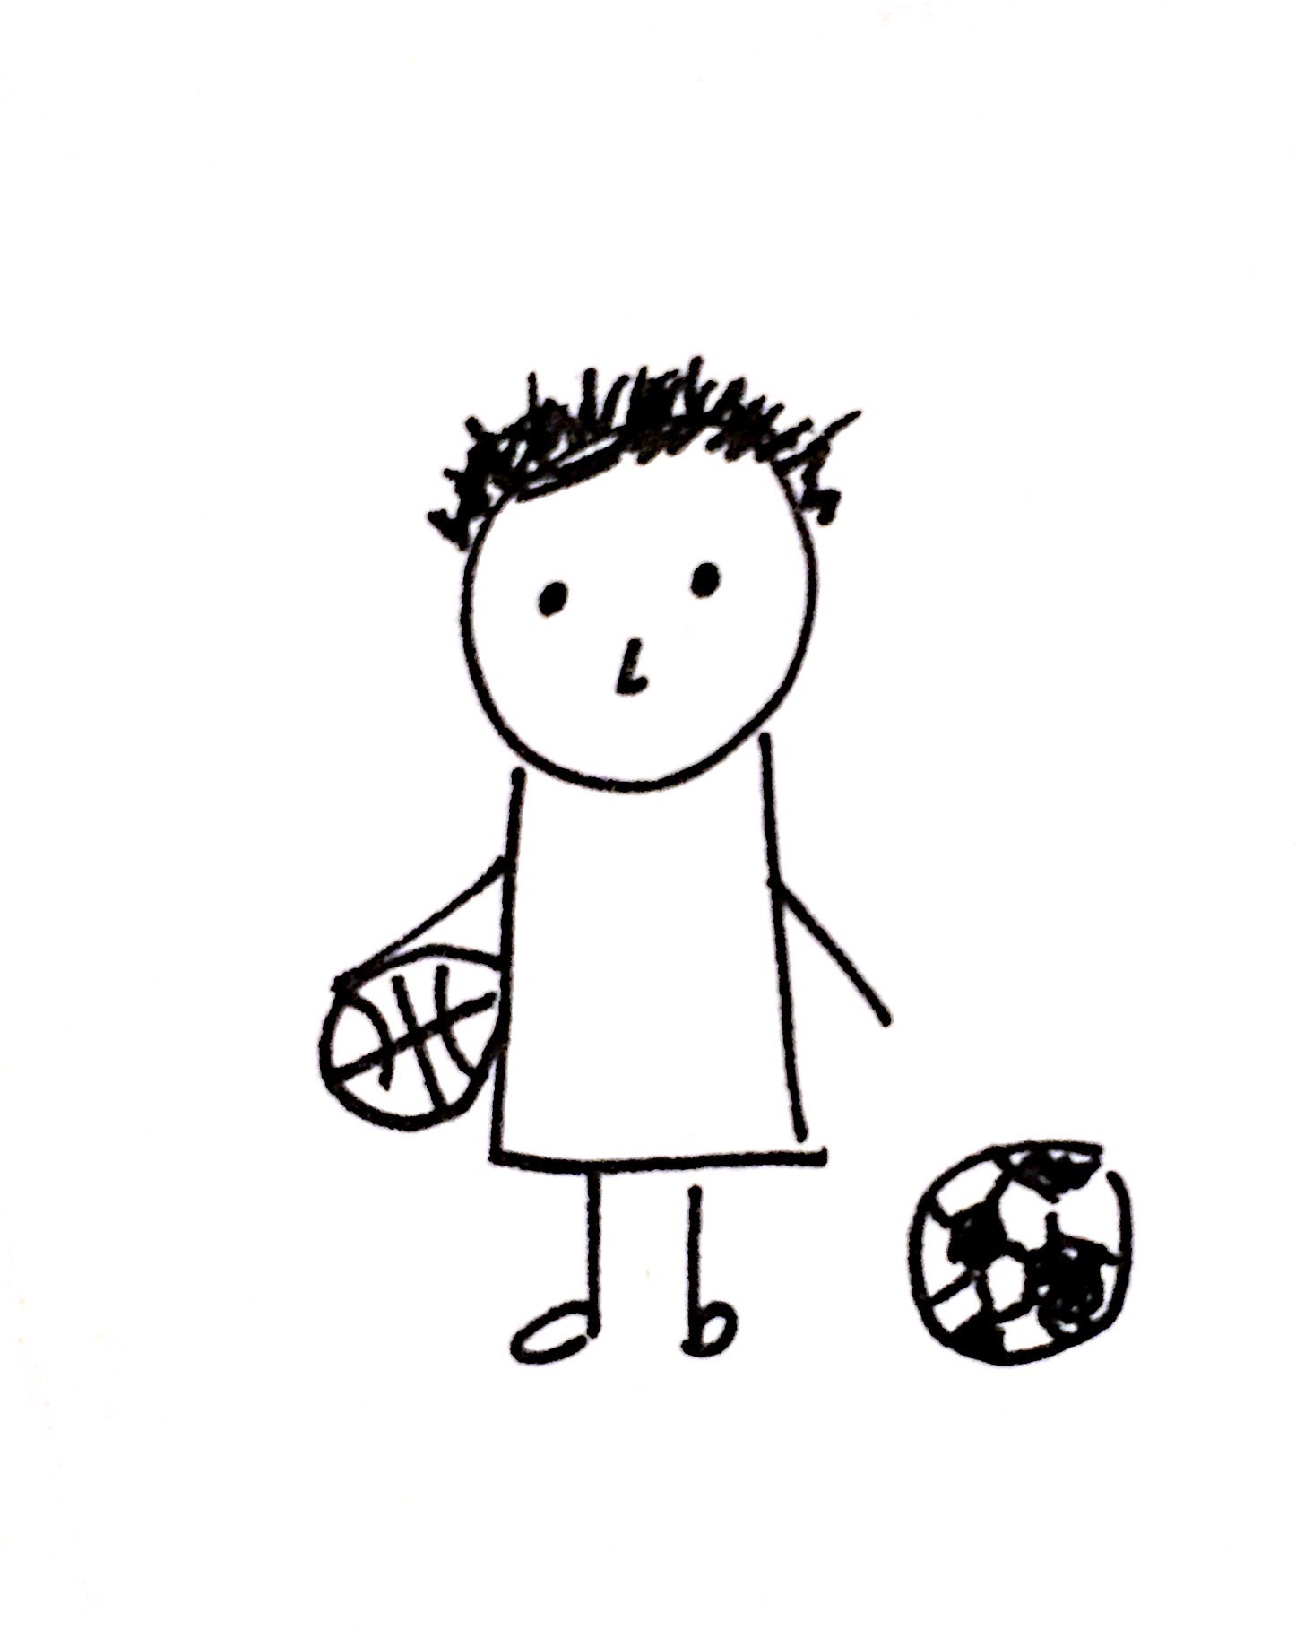
Interview 1 - Teenage Boy in High School
What do you think people can learn in order to take care of themselves better?
“People need to learn…what [are] the issues and problems that they need to let go, and what are the ones they need to recognize that they need to get outside help from.”

Slide 7
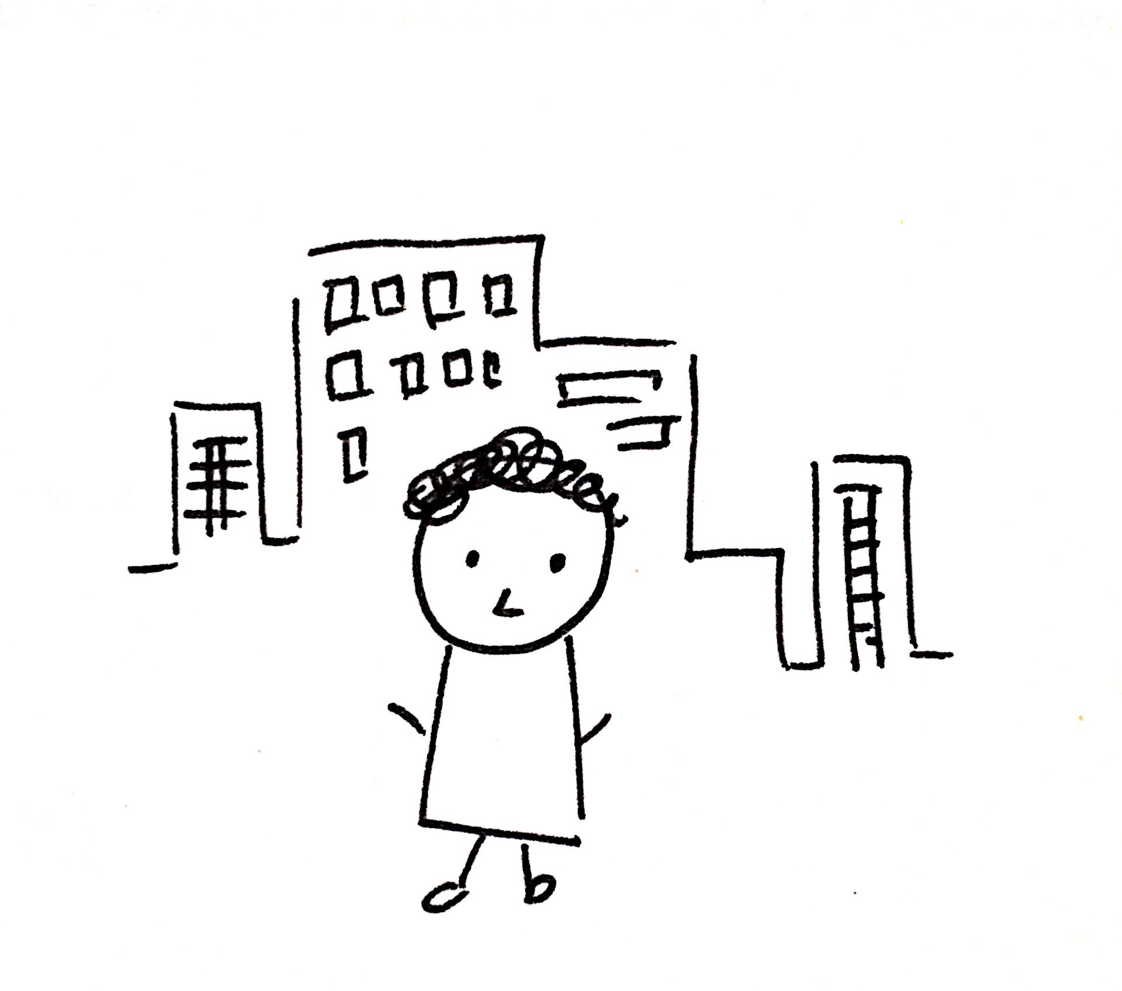
Interview 2 - Young Professional
22 years old, graduated university in 2017
Lives in NYC with 3 friends
Identifies as having struggled with living alone, self-care, and overall mental health issues
Believes he has excellent self-care habits
Target/typical user
*Wanted to remain anonymous*

Slide 8
Interview 2 - Young Professional
“Preventative measures are always the best measures, so I self-regulate by questioning myself everyday and thinking about my decisions, rather than letting it get to the point where I need to respond to something super negative in my life. But it’s hard to keep all of that in check."

Slide 9
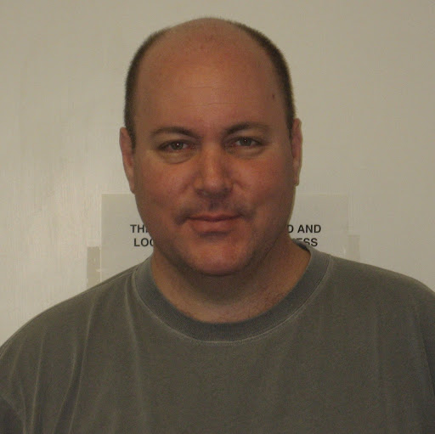
Interview 3 - Residence Dean
Residence Dean for Wilbur Hall
Coordinates care and support on campus
Deals with both mild and extreme student issues

Slide 10
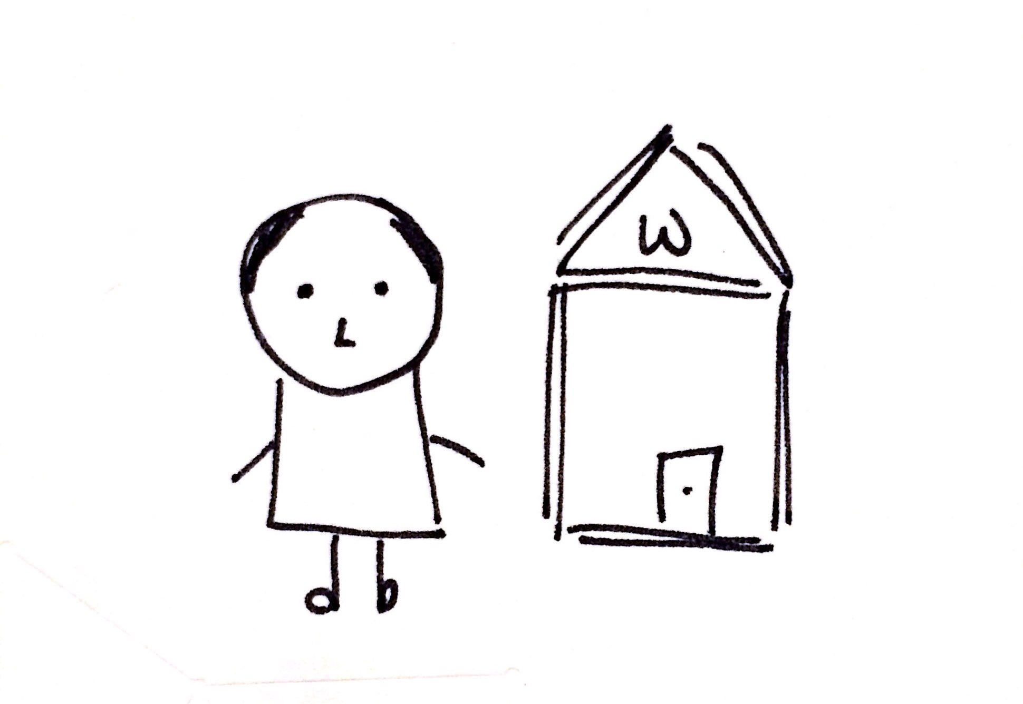
Interview 3 - Residence Dean
What is the best way for people to learn self-care skills?
“I think that self-care is something that is more and more important every year … it needs to normalized in the culture of the community.”

Slide 11
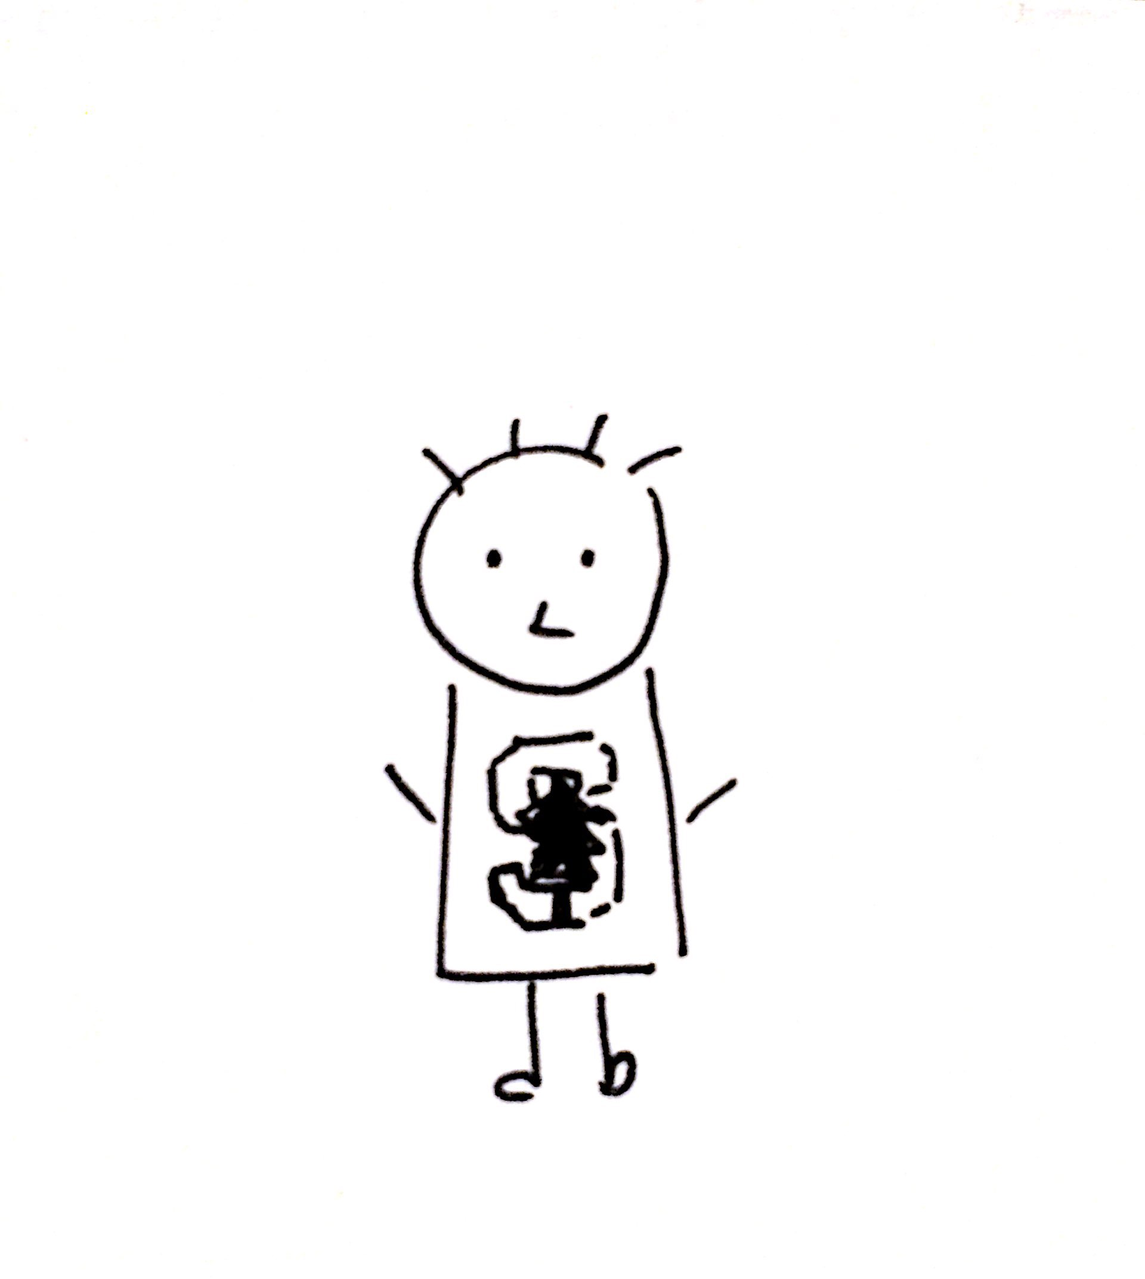
Interview 4 - Stanford student
Stanford senior
Professional and personal experience with mental health sphere
Has worked for a suicide hotline for 4 years
Extreme user
*Wanted to remain anonymous*

Slide 12
Interview 4 - Stanford Student
“There seems to be no balance between just ignoring your mental state and thinking about it constantly, and both can have a negative effect.”

Slide 13
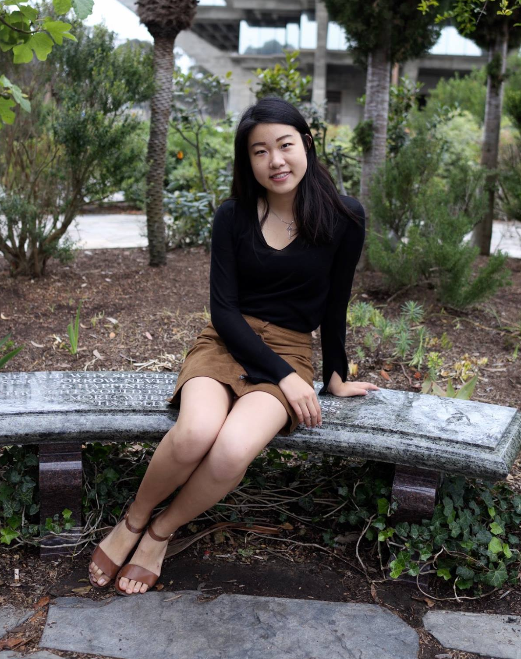
Interview 5 - Non Stanford Student
Undergraduate at UCSD
Studying computer science and spends hours a day on a computer
Active leader in the Women in Tech community on campus
Interviewed at GHC

Slide 14
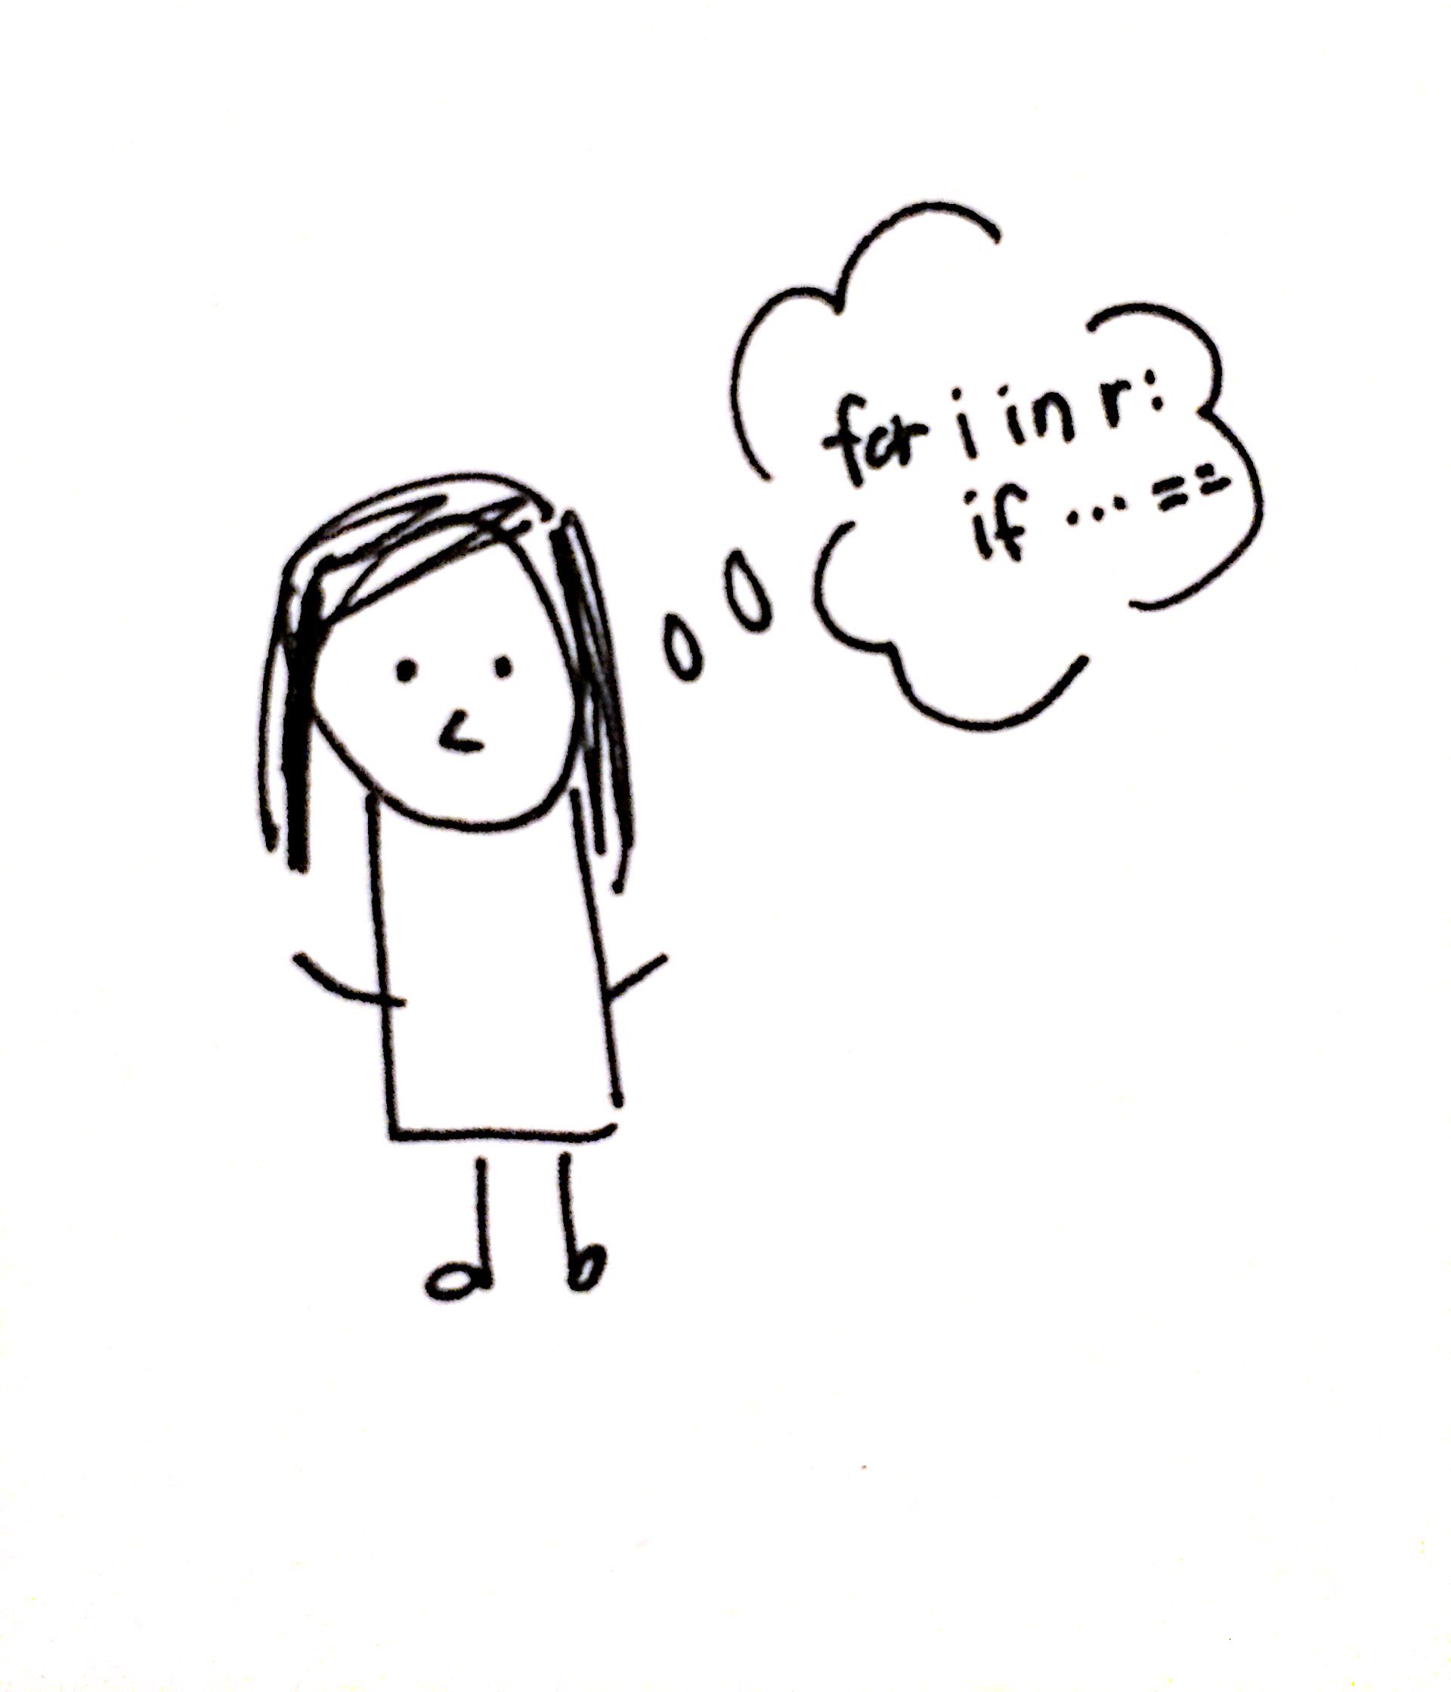
Interview 5 - Non Stanford Student
What do you think is the hardest part of taking care of yourself?
“The hardest part is remembering to. You can sometimes code for 10 hours straight, and you just forgot. But that’s so bad for you. So remembering is hard, and motivating yourself to exercise, to do that run when you don’t want to.”

Slide 16
“I didn’t used to think that much about my happiness and health, until something big happened in my life and I was forced to face it. Self-care has a lot more weight than it did before.”
“People need to learn…which issues they need to let go and for which they should get outside help.”
“I go to a therapist once a week and it’s been really helpful.”
“I wasn’t very good at acknowledging my anxiety.”
“Smart Stanford students take advantage of the resources available to them.”
“My friends help give me perspective to acknowledge which bad habits I really need to pay attention to.”
“Once it starts settling in on you, you start to care.”
“It’s hard to know where to find professional resources and how to make time for them.”
“People think their stress is normal when a lot of the time it really isn’t.”
SAY

Slide 17
Hesitated when talking about their self-care
Serious once the topic switched to self-care
Keeps comfort food on their desk
Sat with a slouched, tired posture
Appeared to know what she was talking about
Maintained less eye contact when asked about whether she were taking care of herself
Talked about past hardships as if he had overcome them
Methodical and analytical about decision-making
Confident in his convictions
DO

Slide 18
College has made me worse at taking care of myself
There are always other things to do that seem more important
I have information and experience that would be useful to others in a similar position
It’s tough to articulate how I practice self-care
I wish I had the time for self-care
I don’t ever take time off just to focus on myself, and I don’t know how to.
I’m much happier now that I’ve learned how I best deal with hardship
THINK

Slide 19
Doubting their own self-care habits
Uncomfortable
Guilt from knowing that they’re not prioritizing self-care
Frustrated with how students normalize high levels of stress
Passionate about providing support and care
Comfortable
Defeated
Like she’s got things under control
FEEL
Proud of himself and his progress

Slide 20
Insights
NEEDS
It’s easy to forget to actively take care of yourself
“ The hardest part is remembering to.”
Reminders to take time in the day to focus on yourself

Slide 21
Insights
NEEDS
Help to realize which of their habits are normal and which are abnormal
“My friends help give me perspective to acknowledge which bad habits I really need to pay attention to.”
“People think their stress is normal when a lot of the time it really isn’t.”

Slide 22
Insights
NEEDS
“People need to learn…which issues they need to let go and for which they should get outside help.”
“My friends and I have had to let go of trying to be perfectionists.”
Distinguishing what is reasonable to be worried about

Slide 23
Insights
NEEDS
Time management
It feels like there’s never enough time to practice self-care and do things for yourself

Slide 24
Insights
NEEDS
People wait until something bad happens for them to take action.
“I didn’t used to think that much about my happiness and health, until something big happened in my life and I was forced to face it.”
To pay attention to self-care before things come to a head

Slide 25
Surprises
Realizes
Mental well-being may be harder to monitor
There are ways to remind people about their well-being
There is room for growth in the way that people learn self-care methods
People worry a lot about mental as well as physical well-being
People forget to take care of themselves
People don’t know when to take action

Slide 26
Questions?

Slide 27
A deeper dive into the empathy map!

Slide 28
SAY
“People need to learn…which issues they need to let go and for which they should get outside help.”
“Sports could be stressful, but it is the only thing I think about when playing.”
“I wasn’t very good at acknowledging my anxiety.”
“My friends and I have had to let go of trying to be perfectionists.”
“My friends help give me perspective to acknowledge which bad habits I really need to pay attention to.”
“I go to a therapist once a week and it’s been really helpful.”
“It’s hard to know where to find professional resources and how to make time for them.”
“Whenever I’m anxious I think about my mental state.”
“People think their stress is normal when a lot of the time it really isn’t.”
“I didn’t used to think that much about my happiness and health, until something big happened in my life and I was forced to face it. Self-care has a lot more weight than it did before.”

Slide 29
SAY
“I base my choices on whether something will benefit me or take a toll on me or stress me out.”
“I’ve adopted a preventative rather than a responsive system toward things that might become issues for me.”
“Smart Stanford students take advantage of the resources available to them.”
“I worry more about the Sophomores.”
“I probably didn’t give a lot of thought to self-care before I started having back problems and feeling uncomfortable.”
“Once it starts settling in on you, you start to care.”
“I don’t manage my time well enough to take care of myself.”
“I think that people trivialize mental health as memes as a way to be relatable or feel better.”
“I would like to be able to manage my time better, and find room for exercise and worrying about health.”

Slide 30
DO
Serious once the topic switched to self-care
Hesitated when talking about their self-care
Keeps comfort food on their desk
Maintained less eye contact when asked about whether she were taking care of herself
Animated hand motions and frustrated tone of voice when self-deprecating humor was mentioned
Sat with a slouched, tired posture
Talked about past hardships as if he had overcome them
Confident in his convictions
Methodical and analytical about decision-making
Appeared to know what she was talking about

Slide 31
THINK
It’s tough to articulate how I practice self-care
I’m in a much better place than I was before
I have information and experience that would be useful to others in a similar position
I wish I had the time for self-care
There are always other things to do that seem more urgent
College has made me worse at taking care of myself
It’s only people who really have their life together that have time for self-care
I’m much happier now that I’ve learned how I best deal with hardship
Physical uncomfort is what makes me aware that I’m not taking care of myself
I don’t ever take time off just to focus on myself, and I don’t know how to

Slide 32
FEEL
Uncomfortable
Somber
Passionate about providing support and care
Defeated
Guilt from knowing that they’re not prioritizing self-care
Frustrated with how students normalize high states of stress
Proud of himself
Comfortable
Confident in the way he lives
Like she’s got things under control

